Slide 1

Biology for Engineers
UNIT I: Lipids (Biodiesel, cleaning agents/detergents)
Lipid obtained from food waste can be used as a potential source for biodiesel preparation.
Generally made by esterifying lipids (e.g., soybean oil, vegetable oil, and animal fat (tallow)) with an alcohol generating fatty acid esters.
Biodiesel is to be utilized in standard diesel engines and is thus well defined from the vegetable and waste oils used to fuel converted diesel engines.
Biodiesel can be used singly or blended with gasoline in any proportions. Biodiesel blends can also be utilized as heating oil.
Oil producing microorganisms when grown under nitrogen-limited conditions can accumulate 20%–80% about their dry weight in the form of lipids (triacylglycerols) that are considered as an alternative substrate for biodiesel processing.

Slide 2
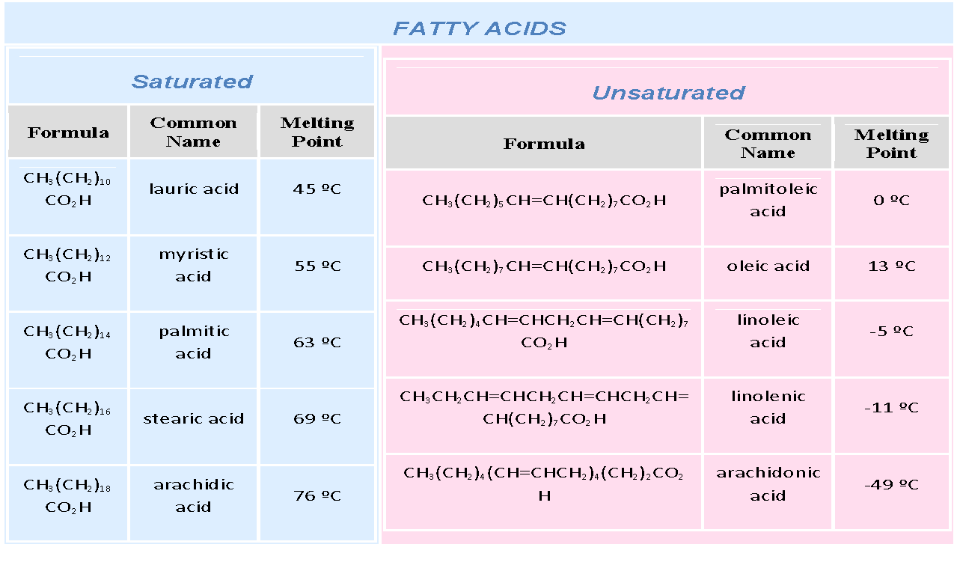

Slide 3
Transesterification is the main commercial method for biodiesel production and requires the use of an alcohol with one to eight carbon atoms (e.g. methanol) and a catalyst.
Esterification prior to the transesterification process is the most common method for reducing the free fatty acid content of the feedstock.
Animal fat gives biodiesel with a high cetane number, which is an important quality parameter for diesel fuels.
Saturated fatty acids are the source of high cetane number and values over 60 are common.
Soybean oil based biodiesel usually has a cetane number of about 48-52 and petroleum-based diesel fuel is usually between 40 and 44.
When animal fat biodiesel is blended with petro-diesel, this high cetane number can help the engine start more quickly and run more quietly.
Cetane number (cetane rating) is an indicator of the combustion speed of diesel fuel and compression needed for ignition. Cetane number is an inverse function of a fuel's ignition delay, the time period between the start of ignition and the first identifiable pressure increase during combustion of the fuel.

Slide 4
Biodiesel or fatty acid methyl esters (FAME) are produced by the transesterification reaction.
This reaction can be catalyzed by acids, bases, or enzymes. In addition, biodiesel can be synthesized under supercritical conditions without using any catalysts.
Yield of biodiesel is generally affected by temperature, molar ratio of lipid to methanol, reaction time and the type of catalyst used
Commercially, bases are used as a catalyst for the large scale biodiesel production due to high biodiesel yield and short reaction time. However, the base catalyzed process is sensitive to moisture and free fatty acid (FFA) content
RCO₂H | + | NaHCO₃ | → | RCO₂⁽⁾ Na⁽⁺⁾ + CO₂ + H₂O
RCO₂H | + | (CH₃)₃N: | → | RCO₂^{(–)} (CH₃)₃NH⁽⁺⁾
RCO₂H | + | AgOH | → | RCO₂^{δ(–)} Ag^{δ(+)} + H₂O

Slide 5
Acid catalysts are not affected by FFA content but requires longer reaction time and higher reaction temperature.
Furthermore, there is an increase in capital cost of the biodiesel production due to the corrosive nature of acids and bases.
As an alternative to the chemical methods, lipases are used for biodiesel production
Lipase catalyzed biodiesel production is moisture and FFA tolerant.
Additionally, biocatalysts are sustainable and require mild reaction conditions. Also, the use of lipase allows for an easy separation of glycerol and catalyst

Slide 6
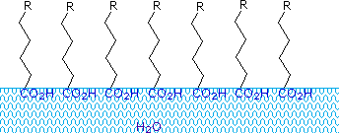
Biology for Engineers
Lipids (Biodiesel, Cleaning agents/detergents)
Lipids as Cleansing Agents
Carboxylic acids and salts having alkyl chains >C₈ exhibit unusual behavior in water due to the presence of both hydrophilic (CO₂) and hydrophobic (alkyl) regions in the same molecule.
Such molecules are termed as amphiphilic or amphipathic.
Fatty acids made >= C₁₀ are nearly insoluble in water, and because of their lower density, float on the surface when mixed with water.
Unlike paraffin or other alkanes, which tend to puddle on the waters surface, these fatty acids spread evenly over an extended water surface, forming a monomolecular layer in which polar carboxyl groups are hydrogen bonded at the water interface, and the hydrocarbon chains are aligned together away from water.
Substances that accumulate at water surfaces and change the surface properties are called surfactants

Slide 7
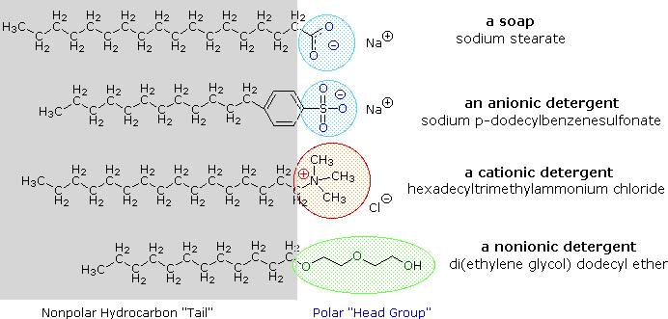
Lipids as detergents
The use of such compounds as cleaning agents is facilitated by their surfactant character, which lowers the surface tension of water, allowing it to penetrate and wet a variety of materials.
In oil biodegradation, the primary role of surfactants is to increase the collision frequency between microbes and oil.
The amphiphilic nature of biosurfactants drives them to partition at material interfaces, alter the interfacial composition and rheology, reduce the interfacial tensions, and increase the interfacial area

Slide 8
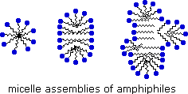
Polar head group -blue circle,
Nonpolar tail - zig-zag black line.
Very small amounts of these surfactants dissolve in water to give a random dispersion of solute molecules.
However, when the concentration is increased an interesting change occurs.
The surfactant molecules reversibly assemble into polymolecular aggregates called micelles.
By gathering the hydrophobic chains together in the center of the micelle, disruption of the hydrogen bonded structure of liquid water is minimized, and the polar head groups extend into the surrounding water where they participate in hydrogen bonding.
These micelles are often spherical in shape, but may also assume cylindrical and branched forms, as illustrated on the right.
The hydrophilic segments might be carbohydrates, polar peptides or acids, while the hydrophobic segments are usually lipids. Accordingly, biosurfactants are classified as glycolipids (e.g., rhamnolipids, trehalolipids, sophorolipids), lipopeptides and lipoproteins, phospholipids, protein–polysaccharide complexes, and membranous vesicles.

Slide 9
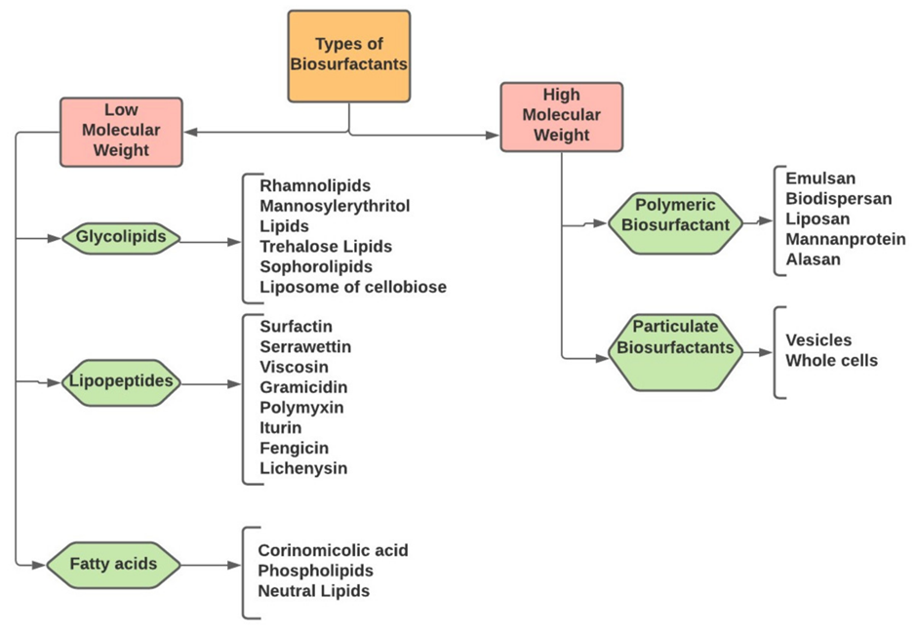
Lipids from microbes: Biosurfactants
For oil–water systems, biosurfactants in synergy with flow break down and disperse one phase into the other; this process is known as emulsification.
Depending on the biosurfactant affinity for each phase (hydrophilic–lipophilic balance) as well as the volume and composition of each phase, the biosurfactants might disperse oil droplets in a continuous aqueous phase (oil-in-water emulsion) or vice versa (water-in-oil emulsion).

Slide 10
Few examples of lipid biosurfactants produced by microbes
Several microorganisms such as bacteria and yeast produce fatty acid and phospholipid, which have increasing demand due to biosurfactant property
Microemulsions of alkanes were produced by these biosurfactants.
Neutral lipids expected to be wax ester-like lipids produced by the marine hydrocarbonoclastic bacteria.
A complex mixture of biopolymers such as proteins, polysaccharides, lipopolysaccharides were the base components of the polymeric surfactants obtained from many bacteria.

Slide 11
Through o-ester linkages the polysaccharides are covalently linked to fatty acids.
Emulsan, liposan, and mannoprotein are the best examples of polymeric biosurfactants
Emulsan shows emulsifying activities under low concentrations.
Emulsan produced by Acinetobacter showed crude oil degradation properties
Liposan produced by yeasts finds a prominent place in the food and cosmetic industries. It forms stable emulsions with edible oils.

Slide 12
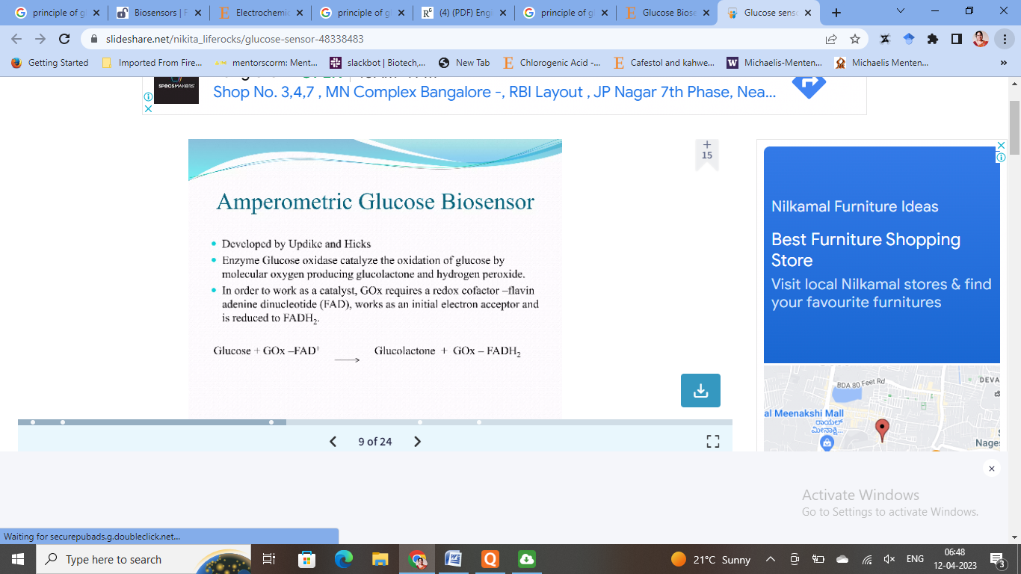
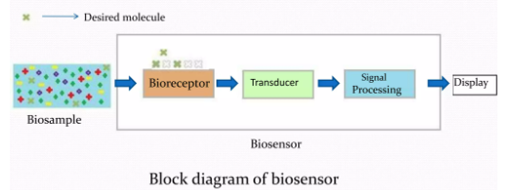
Biology for Engineers
UNIT I: Enzymes (glucose-oxidase in biosensors, lignolytic enzyme in bio-bleaching)
A biosensor is an analytical device which is used to determine the presence and concentration of a specific substance in a biological analyte.
Enzyme Glucose oxidase catalyzes the oxidation of glucose by molecular oxygen producing gluconolactone and hydrogen peroxide.
In order to work as catalyst, GOx requires a redox cofactor- FAD that works as an initial electron acceptor and is reduced to FADH₂

Slide 13
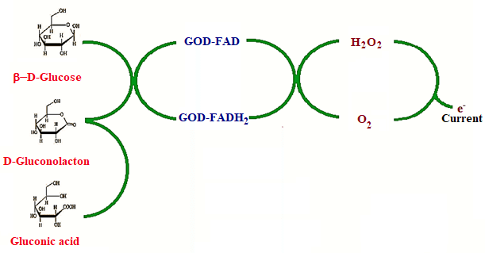
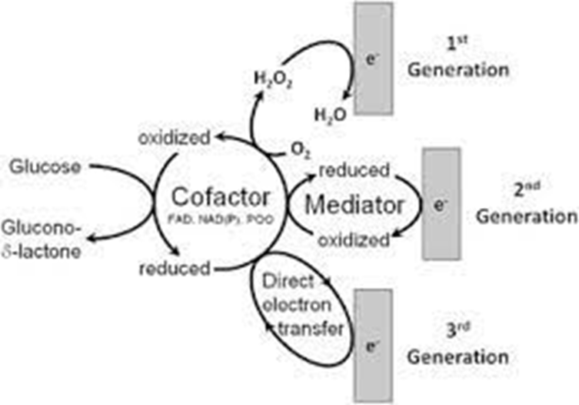
Basic working principle for glucose biosensors : (a) Glucose binds in the enzymatic binding pocket of glucose oxidase (GOX).
(b) An applied potential catalyzes the oxidation of glucose to gluconic acid and hydrogen peroxide.
(c) Hydrogen peroxide dissociates to O₂ , 2H⁺ , and 2 free electrons; electrons are measured using electrochemical or optical techniques

Slide 14
Electrochemical biosensors are classified into two groups: amperometric and potentiometric sensors.
Amperometric biosensors are based on the redox output electrochemical signal under a defined potential.
The amperometric method is the commonly used method in the design of electrochemical biosensors.
Amperometric biosensors -production of a current when a potential is applied between two electrodes and the analyte undergoes, or is involved in, a redox reaction that can be followed by measuring the current in an electrochemical cell.
Potentiometric biosensors make use of ion-selective electrodes in order to transduce the biological reaction into an electrical signal.
In the simplest terms this consists of an immobilized enzyme membrane surrounding the probe from a pH-meter, where the catalyzed reaction generates or absorbs hydrogen ions.

Slide 15
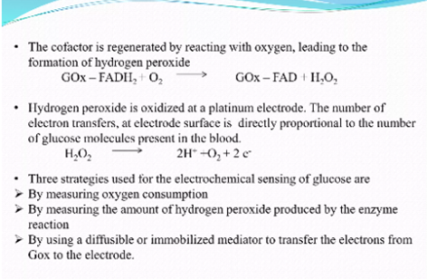
The cofactor is regenrated by reacting with oxygen, leading to formation of Hydrogen peroxide.
Hydrogen peroxide is oxidized at a platinum, electrode. The no. of electron transfers at the electrode surface is directly proportional to the number of glucose molecules present in the blood.
H₂O₂→ 2H⁺ + O₂ + 2 e⁻
Three stategies used for electrochemical sensing of glucose are
By measuring oxygen consumption
By measuring amount of H₂O₂ produced by the enzyme reaction
By using a diffusible or immobilized mediator to transfer the electrons from Gox to the electrode.

Slide 16
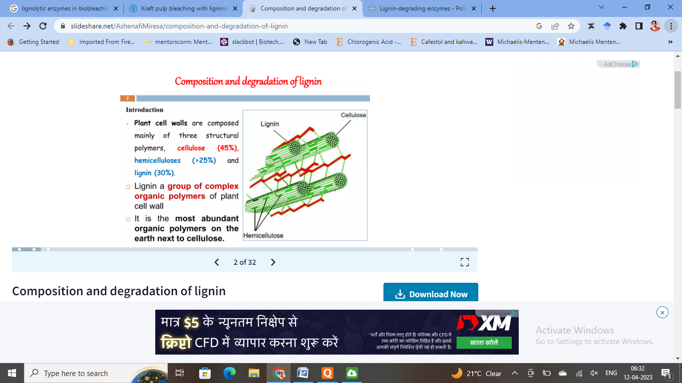
Biology for Engineers UNIT I: Enzymes (lignolytic enzyme in bio-bleaching)
Pitch is composed of fatty acids, resin acids, sterols, glycerol esters of fatty acids, other fats, and waxes.
It is less than 10% of the total weight of wood but causes major problems.
Pitch reduction with enzymes is a very efficient method.
Different lipases have been used for removal of pitch.
Reduces defects on paper, other advantages:ecofriendly and nontoxic technology, improved pulp and paper quality, reduction in bleaching chemical consumption, reduction of effluent load, and space and cost saving in a mill wood yard

Slide 17
Enzymes in Biobleaching
In pulp and paper industry, the most important application of enzymes is in the prebleaching of kraft pulp.
Xylanase enzymes have been found to be most effective for this purpose.
Enzymes have also been used to increase pulp fibrillation and water retention and to reduce beating time in virgin pulps.
With recycled fibers, enzymes have been used for deinking and to restore bonding and increase freeness.
Specialized applications include the reduction of vessel picking in tropical hardwood pulps and the selective removal of xylan from dissolving pulp.
Enzymes have also been investigated for removal of bark, shives, pitch, and slime and for retting of flax fibers.

Slide 18
Bleaching
The removal of lignin from chemical pulps is called bleaching, and it is necessary for aesthetic reasons and for improvement of paper properties.
Present-day bleaching of kraft pulp uses large amounts of chlorine and chlorine chemicals.
Byproducts from using these chemicals are chlorinated organic substances, some of which are toxic, mutagenic, persistent, and bioaccumulating and cause numerous harmful disturbances in biological systems.
Enzymes provide a very simple and cost-effective way to reduce the use of chlorine, chlorine compounds, and other bleaching chemicals.
So far, two enzyme-based approaches have been investigated. One uses hemicellulase enzymes, and the other uses ligninolytic enzymes.

Slide 19
Fibre Modification Deinking
Proven on laboratory and industrial scale to be an effective and economical method Drainage enhancement is known to be a secondary benefit of enzymatic deinking.
Possess superior physical properties, higher brightness, and lower residual ink compared to chemically deinked recycled pulps.
More importantly, size distribution and shape of ink could be effectively controlled using the enzymatic process to maximize the efficiency of size-based flotation process.
Achieved by selectively varying enzyme composition, charge, and residence time as well as varying other additives and pH in the system to effectively dislodge the ink particles into much fewer and nonplatelet forms.
Also improves freeness compared to chemically deinked pulps.
Results in decreased energy consumption in the production of thermomechanical pulps and increased beatability of chemical pulps or improvement of fiber properties.
In high yield mechanical pulps, most of the lignin and hemicellulose remains in the pulps.
Enzymatic modifications to the composition of mechanical pulps can be achieved only on the outer surface of the fiber using xylanases
Improved treatment when combined with an alkaline pretreatment,

